Slide 1
26 JUN 2025
Habitat Mapping Model: A Step-by-Step Approach to Creating Useful Habitat Maps
Boris Hinojo , Federico Cheda, Yago Alonso (3edata) and Melanie Arp (Sensing Clues)

Slide 2
Habitat Mapping Model
More
than a map

Slide 3
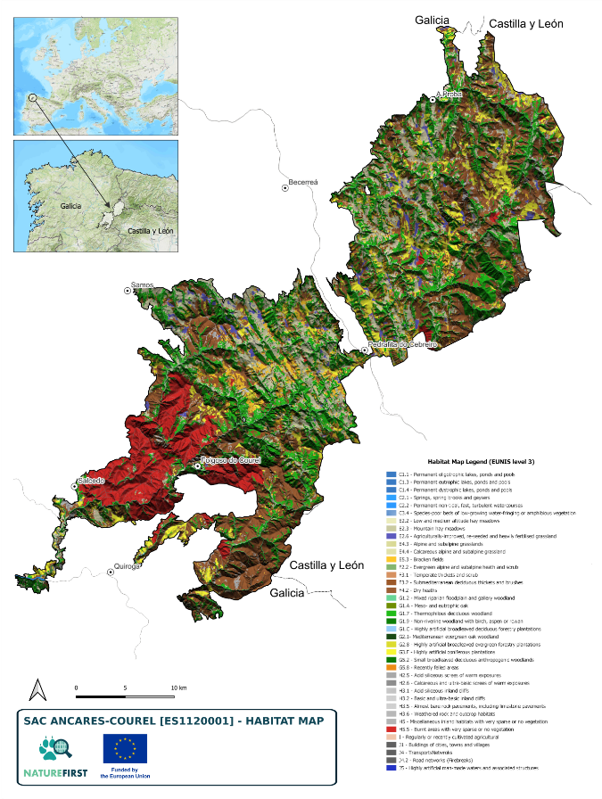
More than a map
A Model for Habitat Mapping and Assessment
Automatic classification of multi-spectral images
Integration of previous thematic cartography
Validation rules and habitat definition Manager
Integration of information on pressures and threats
Calculation of variables for assessing conservation status
Facilitate the definition of conservation objectives (SSCOs)
Reduce costs of production, updating and data management.

Slide 4
Internal Functioning of the Model
General scheme. Mapping
Image classifier
EUNIS
Thematic layers Integration
Specific Rules for habitats
Generation of final map
EUNIS/HCI
Based on multispectral images and Training Areas network.
Incorporation of habitats through thematic layers.
Determination of habitats using a decision tree.
Structure of the information and export of results.

Slide 5
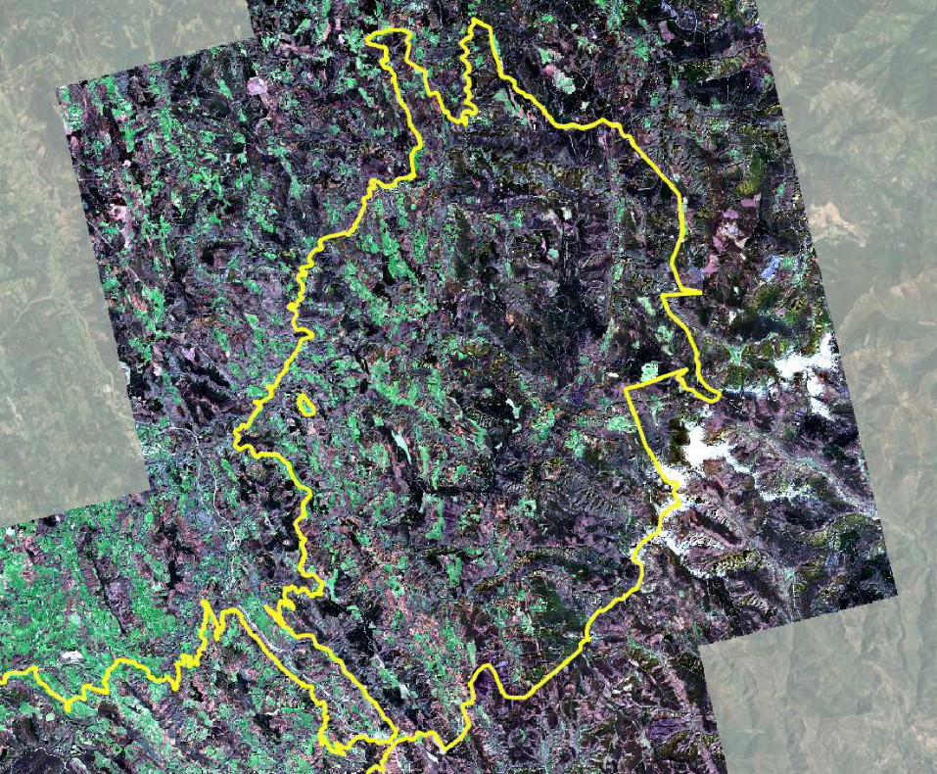
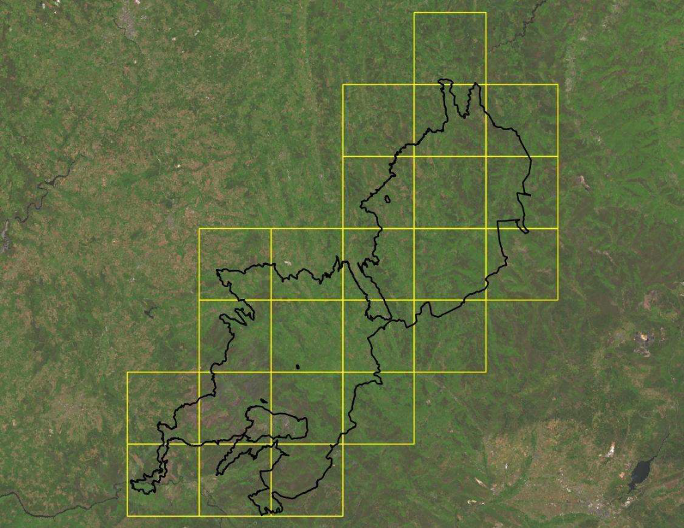
Internal Functioning of the Model
Minimal unit of analysis
Multispectral image mosaics.
Classification system based on N images
Basic unit of analysis (cells) 10x10km grid
for Sentinel 2 imagery

Slide 6
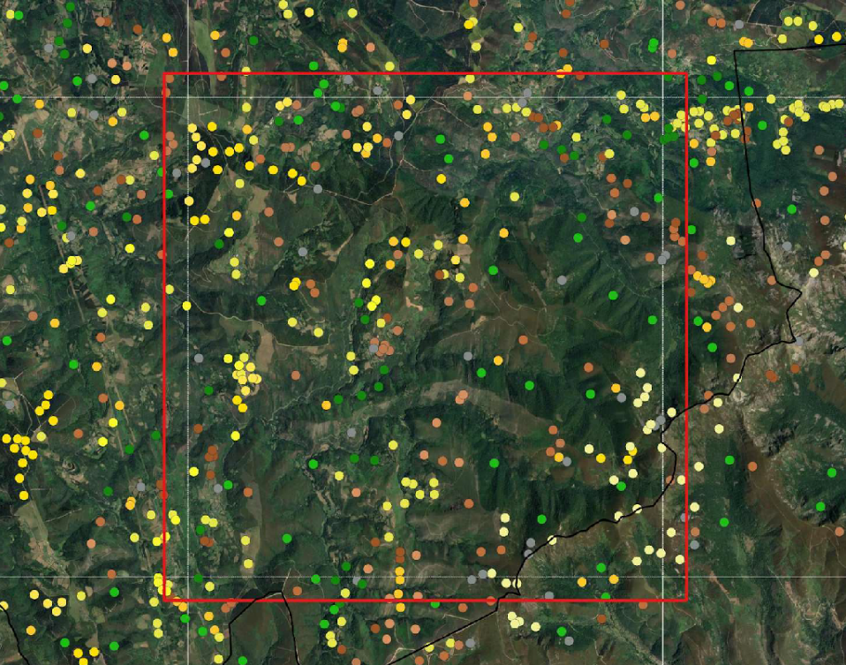
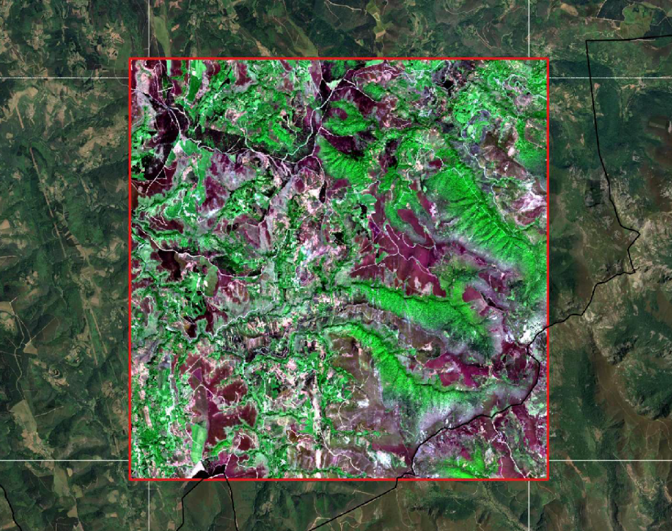
Internal Functioning of the Model
The importance of the Ground Truth
Network of Training Areas. Labelled with maximum known level of EUNIS classification.
Densification and determination of classes adapted to each cell 10x10km.

Slide 7
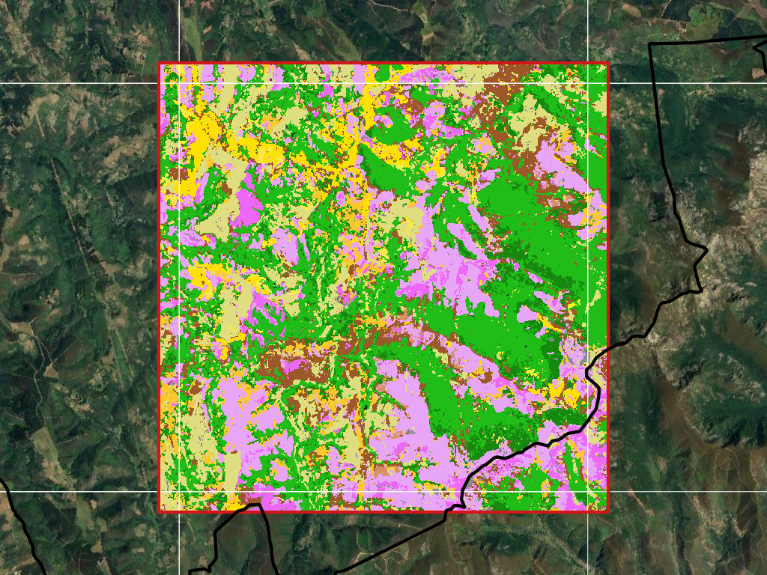
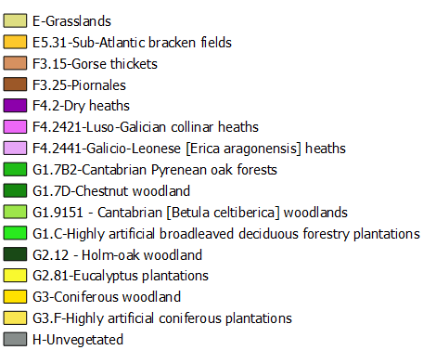
Internal Functioning of the Model
Spectral response of a habitat
EUNIS classes in the Image Classifier product (Raster format)

Slide 8
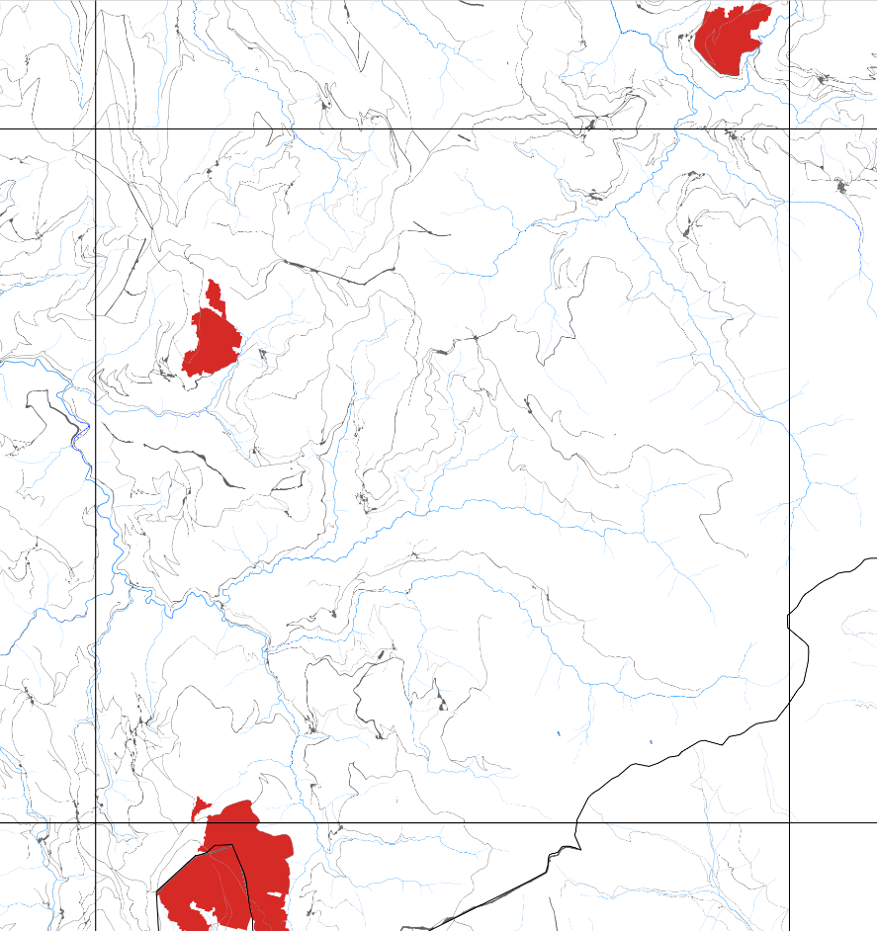
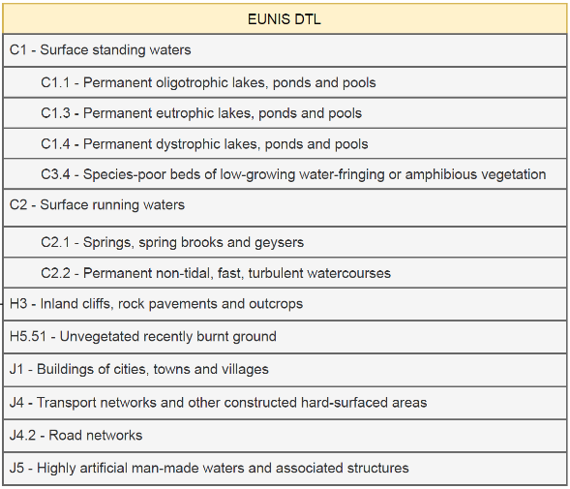
Internal Functioning of the Model
Thematic layers Integration
Integration of previous reference cartography. Classes easily assimilated with a EUNIS category, with proven accuracy and reliability. Examples:
Water bodies and river channels
Buildings/Urbanizations
Communication
Infrastructures
Burnt areas

Slide 9
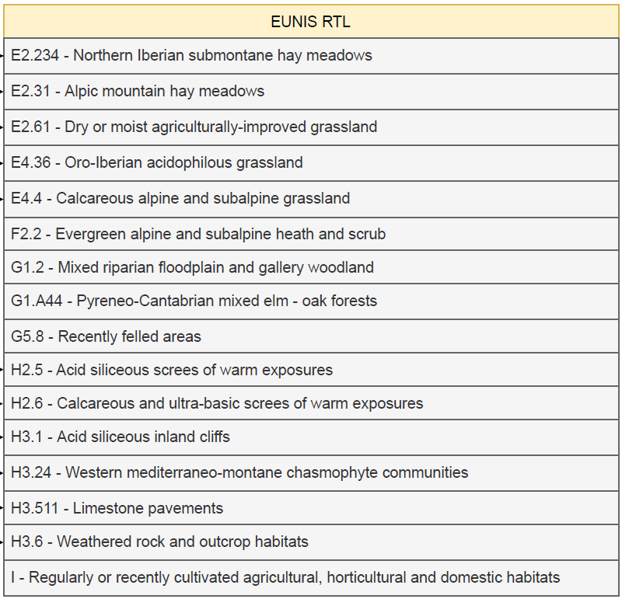
Internal Functioning of the Model
Specific Rules for habitats [RTL]
Analysis of previous cartography and biogeographic information.
Definition of rules for assigning new EUNIS categories not previously identified.
Examples:
Altitude map
Slope map
Geologic map
Agrarian maps (CAP)

Slide 10
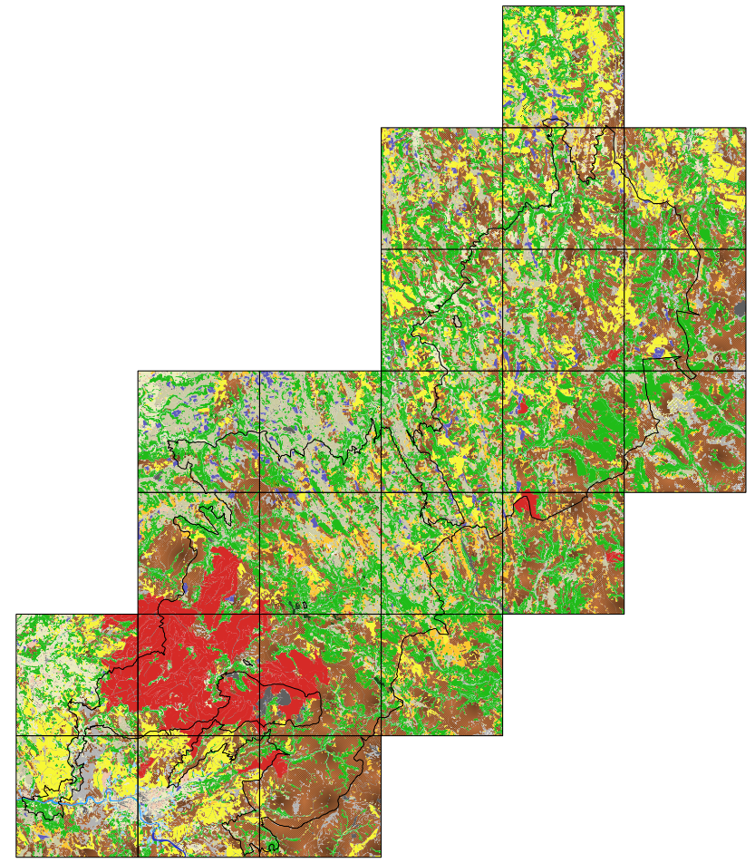
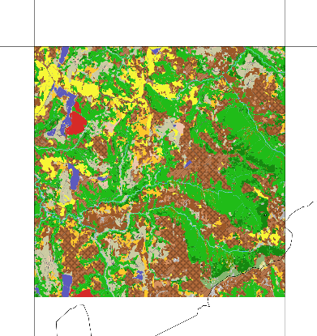
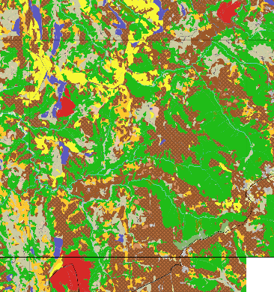
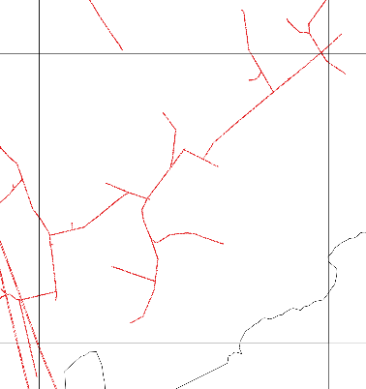
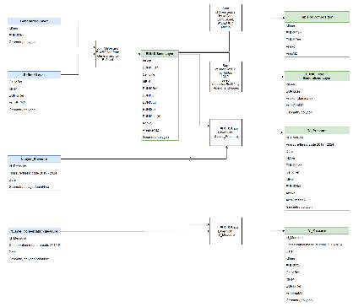
Internal Functioning of the Model
Generation of final map
EUNIS base layer
EUNIS Level 3
Pressures (power line)
Relationship structure

Slide 11
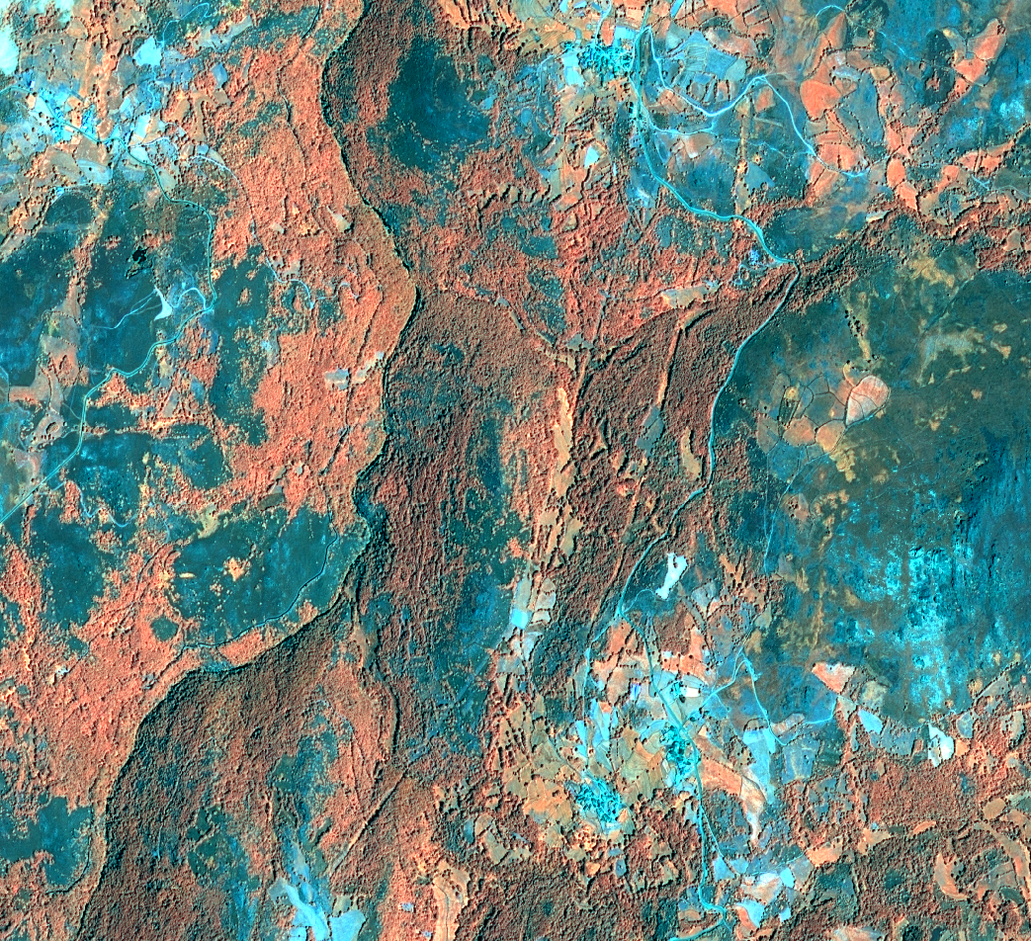
Internal Functioning of the Model
Habitat monitoring. Assessment of conservation status
Updating of the habitat mapping.
Automatic change detection.
Analysis of the dynamics of occupation.
Processes of continuous improvement of the Model.
Improve the capacity for multi-scale analysis.

Slide 12
WORKFLOW Producing the Habitat Map Through the Habitat Mapping Model

Slide 13
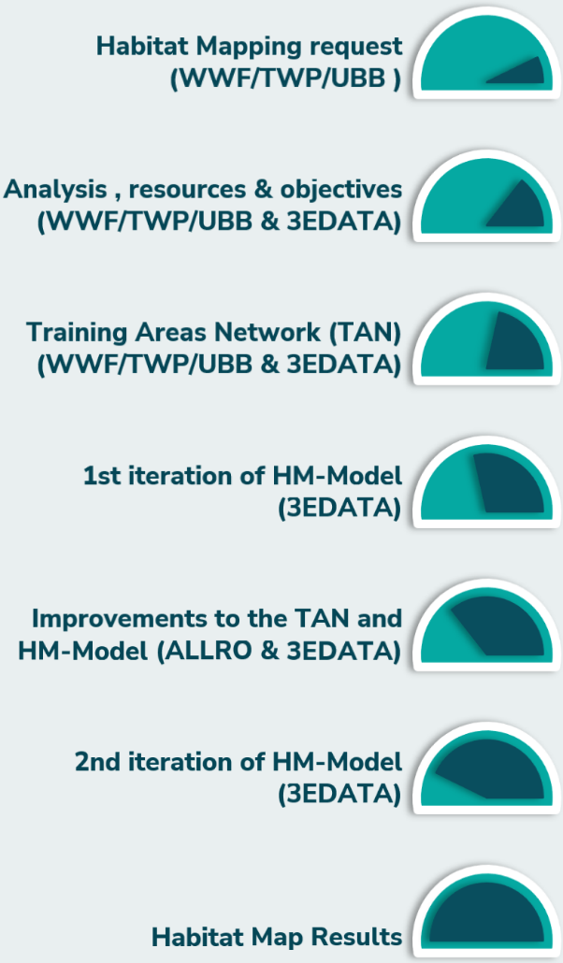
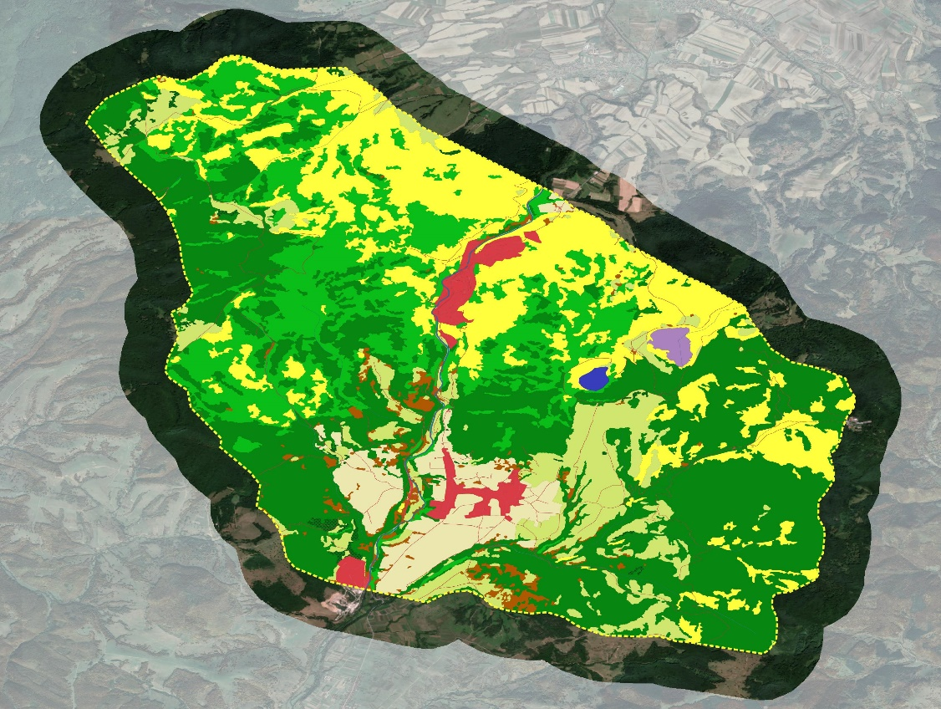
Workflow. Interaction process
Use case: Băile Tușnad

Slide 14
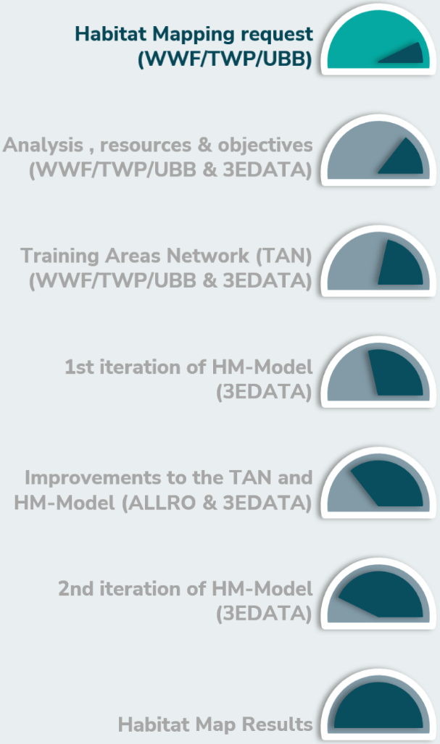
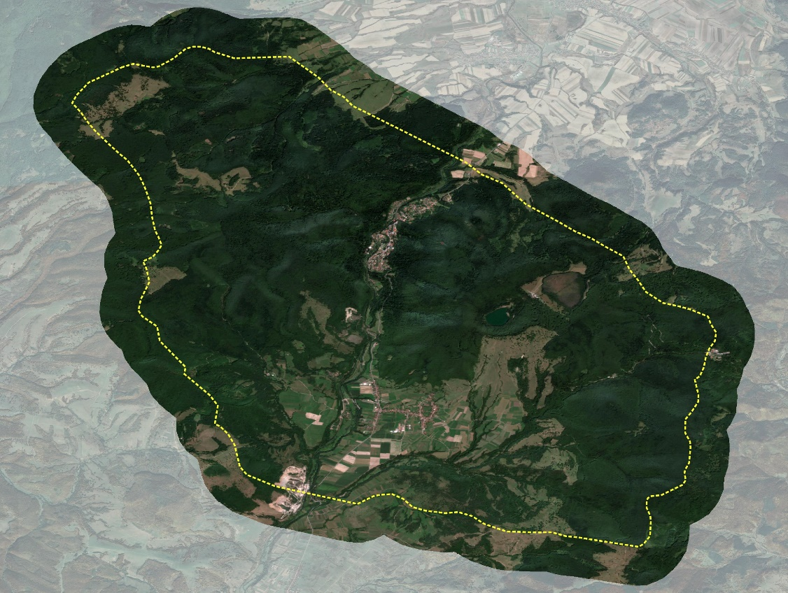
Workflow. Interaction process
Use case: Băile Tușnad

Slide 15
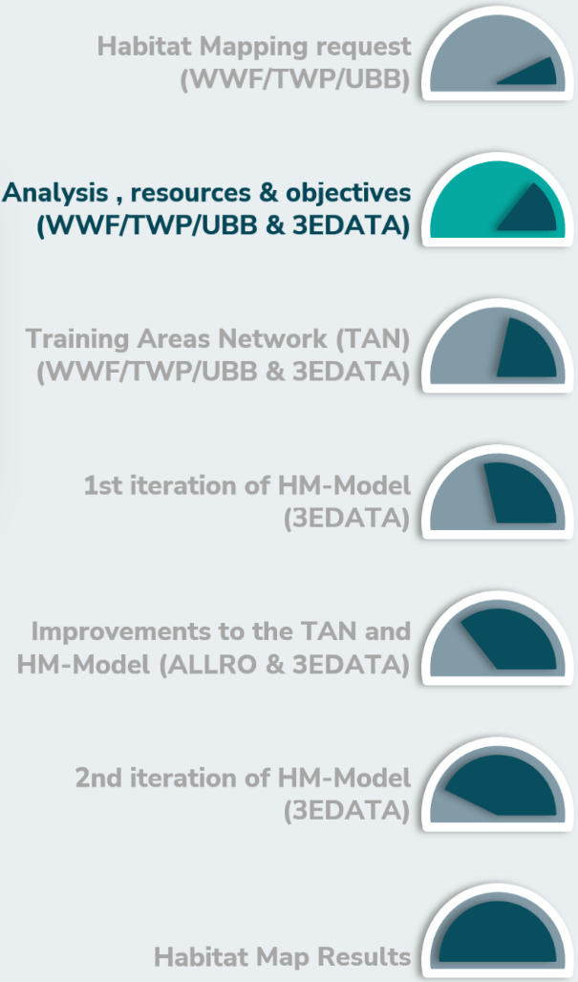
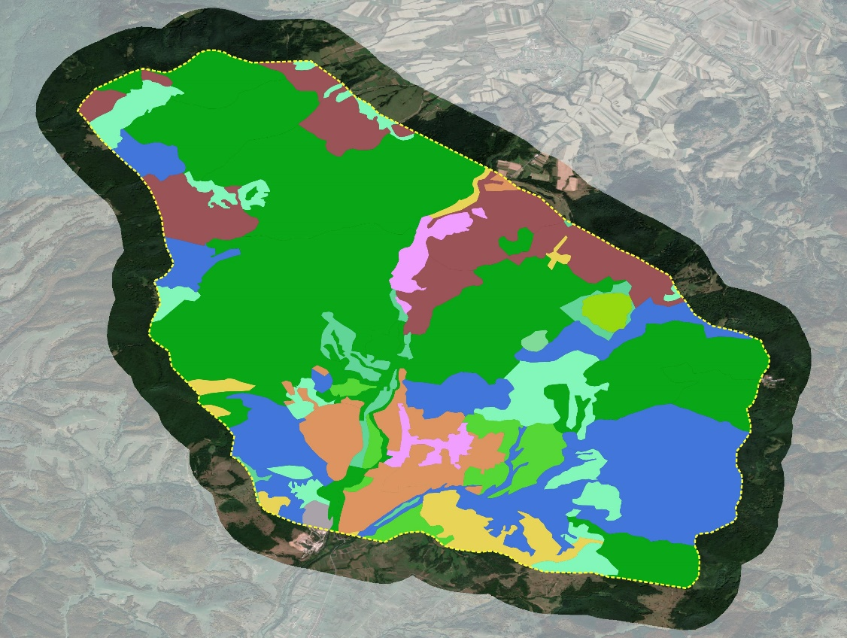
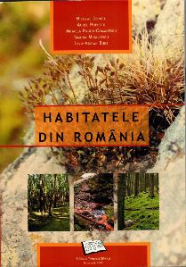
Workflow. Interaction process
Use case: Băile Tușnad

Slide 16
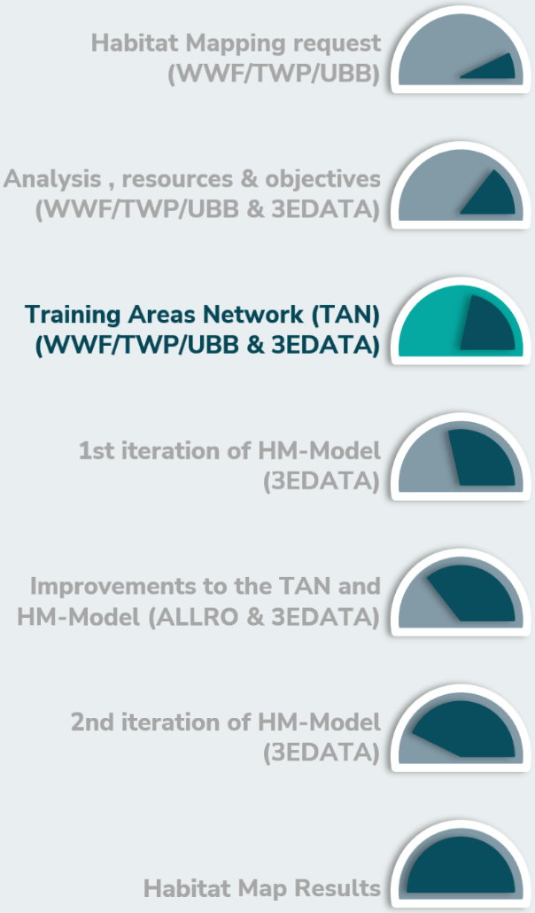
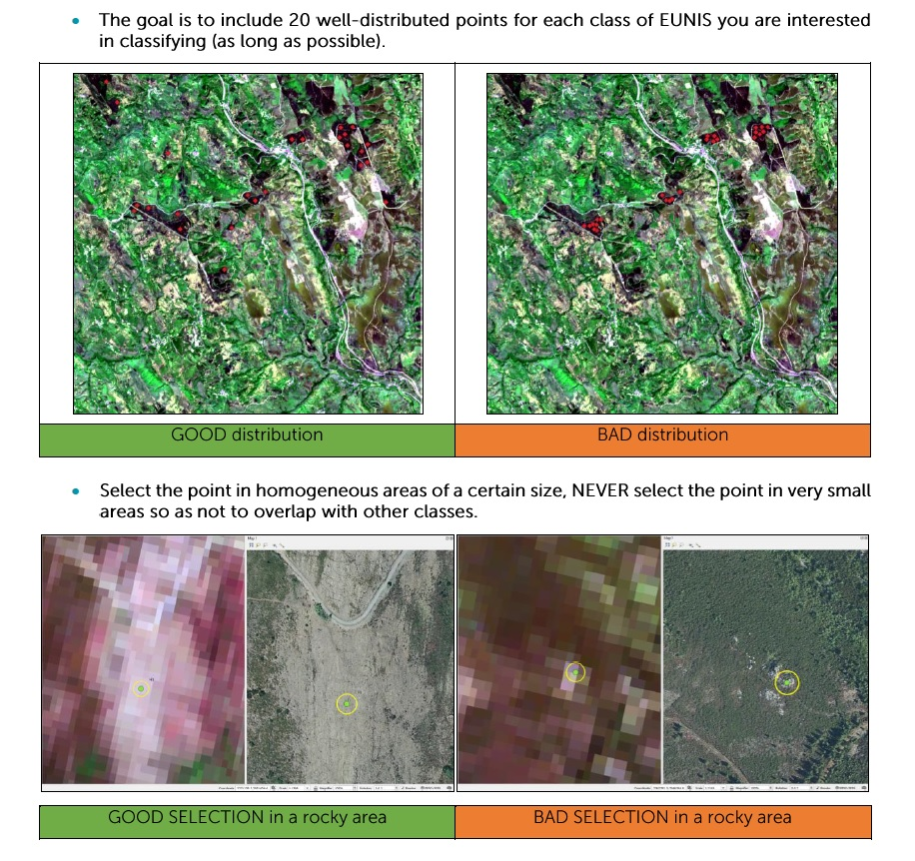
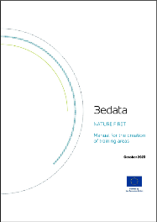
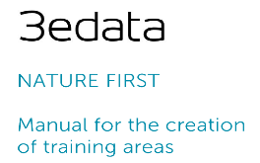
Workflow. Interaction process
Use case: Băile Tușnad

Slide 17
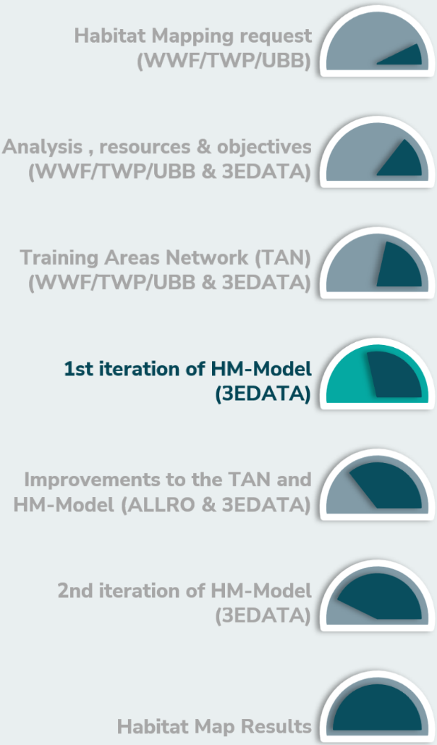
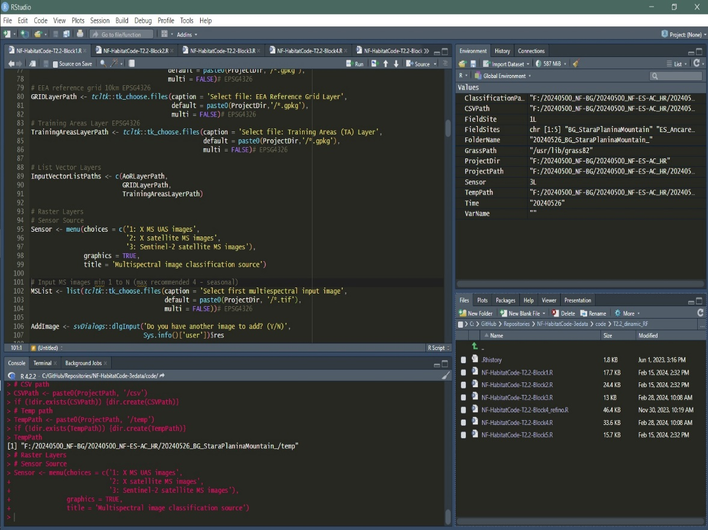
Workflow. Interaction process
Use case: Băile Tușnad

Slide 18
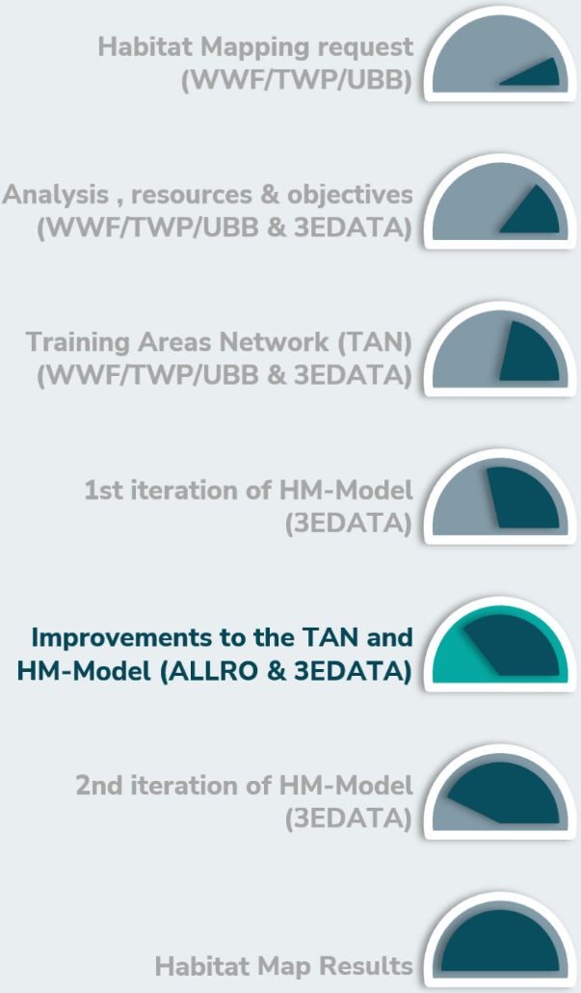
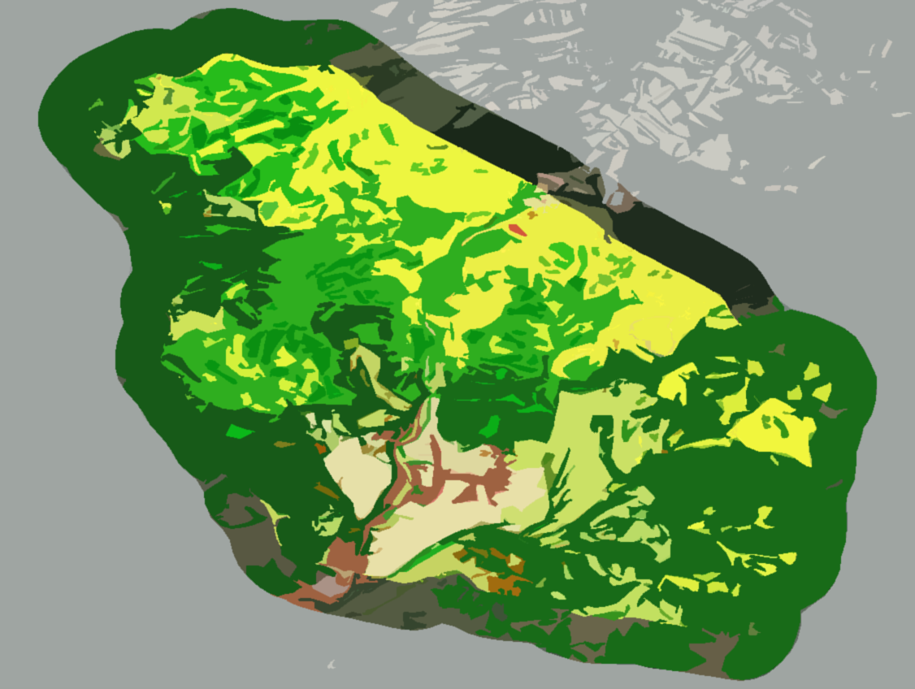
Workflow. Interaction process
Use case: Băile Tușnad

Slide 19
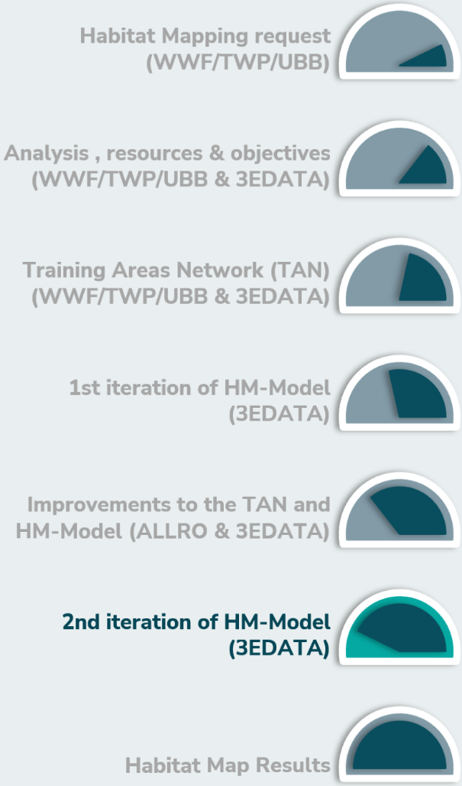
Workflow. Interaction process
Use case: Băile Tușnad

Slide 20
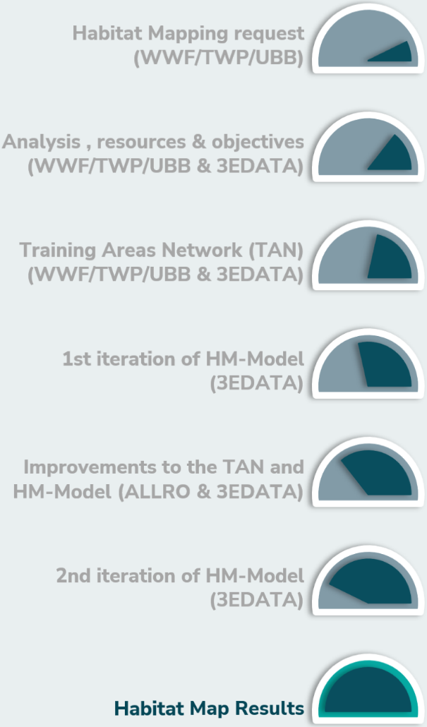
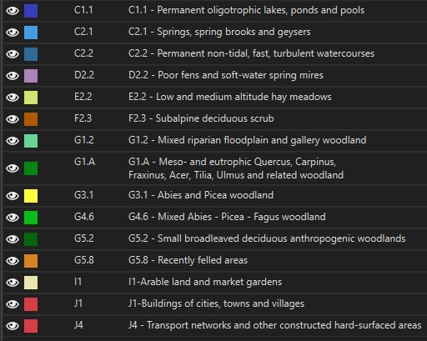
Workflow. Interaction process
Use case: Băile Tușnad
AoI: 108 km2
10Km Cells: 4
EUNIS classes: 15
Annex I Habs: 8
TA: 224

Slide 21
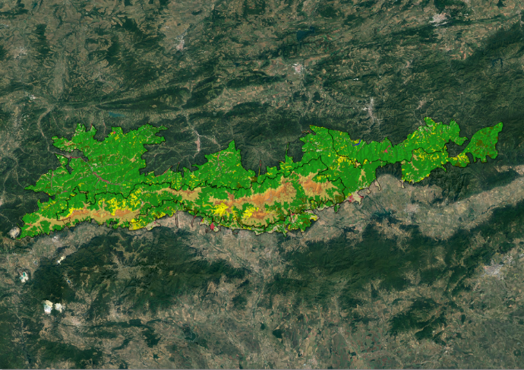
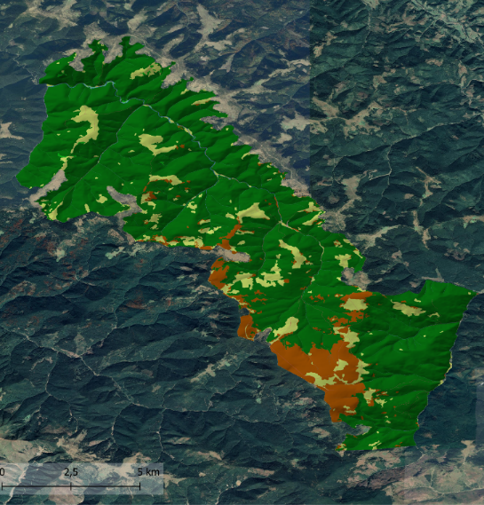
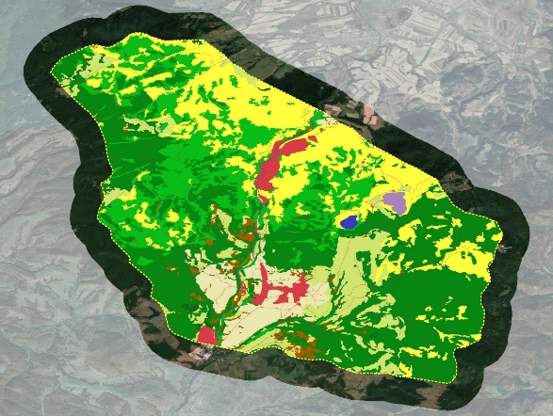
RESULTS DEMONSTRATION
Area of Interest: 2,346 km2
10Km Cells: 52
EUNIS classes: 29
Habitats of community interest: 22
Training Areas: 2,550
Area of Interest: 119,46 km2
10Km Cells: 8
EUNIS classes: 11
Habitats of community interest: -
Training Areas: 582
Area of Interest: 1,026 km2
10Km Cells: 23
EUNIS classes: 44
Habitats of community interest: 16
Training Areas: 5,093
AoI: 108 km2
10Km Cells: 4
EUNIS classes: 15
Habitats of community interest: 8
TA: 224

Slide 22
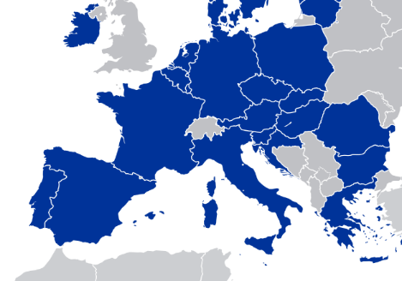
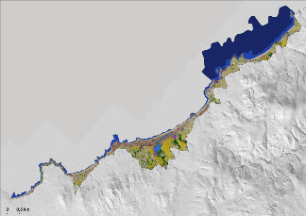
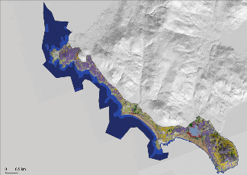
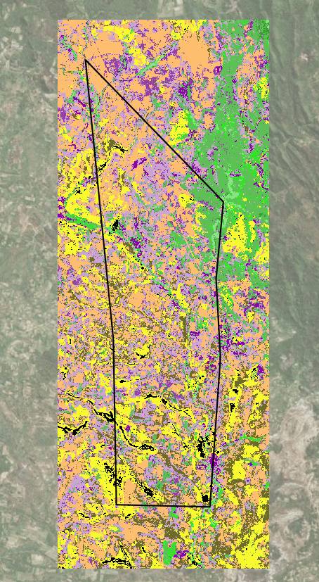
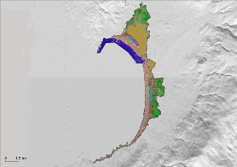
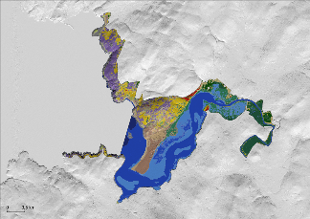
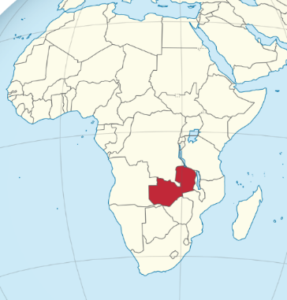
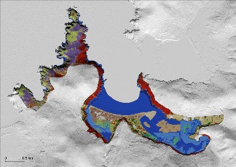
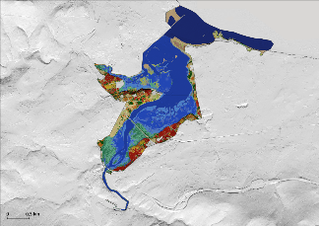
RESULTS DEMONSTRATION
Wikipedia
Wikipedia

Slide 23
Habitat Mapping
Collecting training points - remote observations

Slide 24
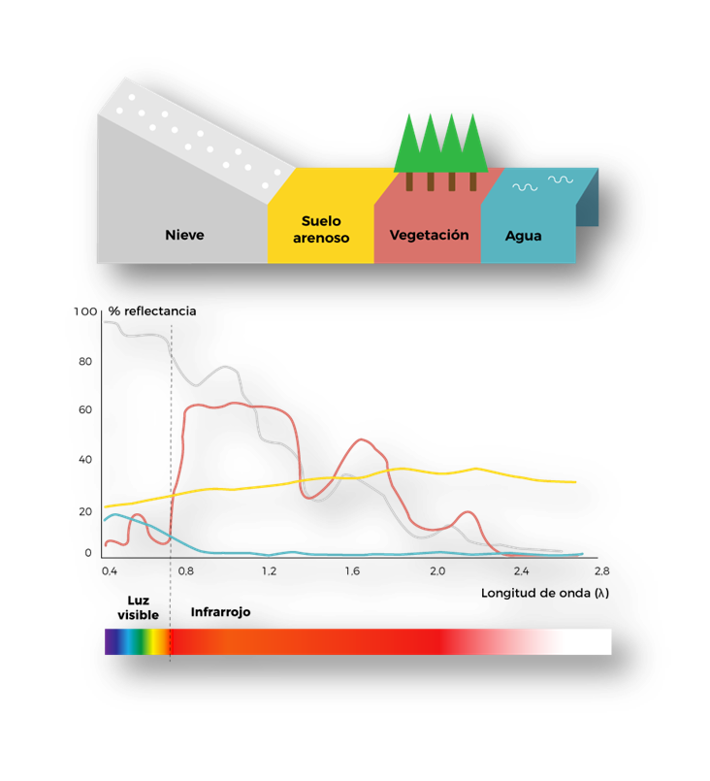
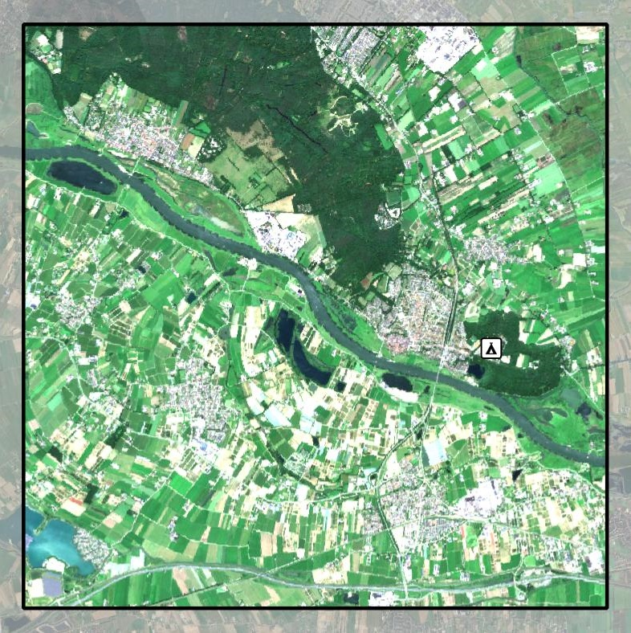
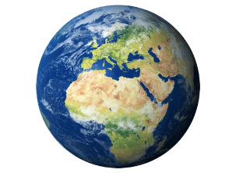
Training Point Collection
Introduction to the use of satellite imagery and photointerpretation
SUN
EARTH
SAT
Multispectral Images from Sentinel2 (RGB)
Rhenen area - June 2025

Slide 25
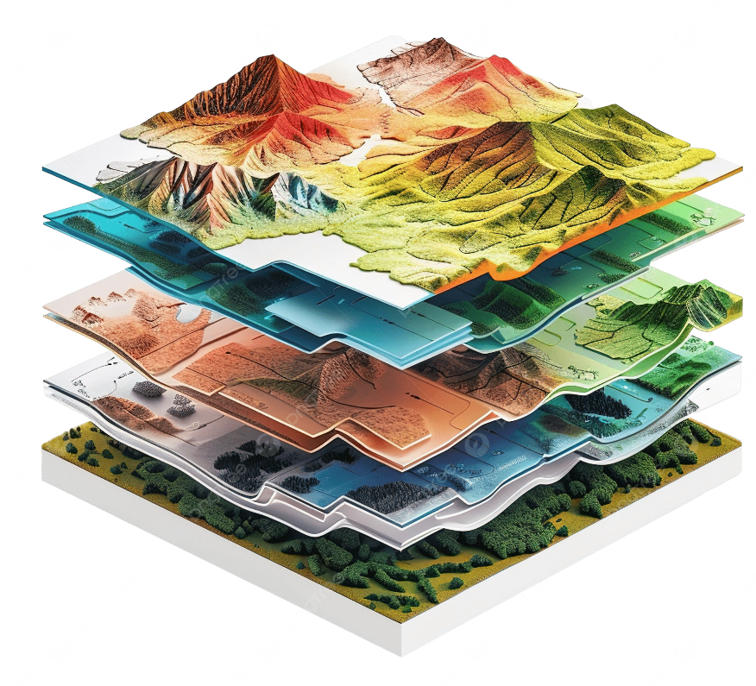
Training Point Collection
Use of Geographic Information Systems (GIS) tools
Multispectral Images from Sentinel2 ( bands NIR-Red-Green)
Rhenen area - June 2025

Slide 26
Training Point Collection
Study of the Area of Interest (AoI)
Habitat
Map
request
EUNIS Level 1
AoI + EUNIS Training Point Level 1

Slide 27
Training Point Collection
Initial definition of target classes
EUNIS Level 2
Habitat
Map
request
Analysis of existing information
Initial overview of mapping objectives
EUNIS Habitats Map Level 2 - EEA

Slide 28
Training Point Collection
Initial definition of target classes
EUNIS Level 2
Habitat
Map
request
Analysis of existing information
Initial overview of mapping objectives
EUNIS Habitats Map Level 2 - EEA

Slide 29
Training Point Collection
Initial definition of target classes
EUNIS Level 2
Habitat
Map
request
Analysis of existing information
Initial overview of mapping objectives
Multispectral Images from Sentinel2 (8-4-3)
Rhenen area - March 2025

Slide 30
Training Point Collection
Integration of expertise and local knowledge to refine Training Points
Experts help us go deeper in defining training points
Fieldwork confirms what is really on the ground.
It can also help identify new Training Points.

Slide 31
Habitat Mapping
Collecting training points - field observations

Slide 32
Training Point Collection
Do you have people in the field?
Do they patrol the project area?
Do they have knowledge about the local habitat?

Slide 33
Training Point Collection
The mobile application

Slide 34
Training Point Collection
Navigate to the points

Slide 35
Training Point Collection
Recording the habitat

Slide 36
Scenario: Mapping the Zoo
Who volunteers for the position of ground truth seeker?

Slide 38
Habitat Mapping
Internal Functioning of the Model

Slide 39
Internal Functioning of the Model
Predictive Model
Thematic layers Integration
Specific Rules for habitats
Generation of final map
EUNIS/HCI
Determination of habitats using rules based on thematic layers or without thematic layers.
Based on multispectral images and Training Areas network (TA).
Incorporation of habitats through thematic layers.
Structure of the information and export of results.

Slide 40
Predictive Model
Thematic layers Integration
Specific Rules for habitats
Generation of final map
EUNIS/HCI
Sentinel 2 Images
Training Points
Process in which we train a supervised classification algorithm using the training points as reference data.
Specifications:
Random Forest
Full spectral band data and vegetation index
RF per cell
Only classes that appeared in cell
Predictive model

Slide 41
Predictive Model
Thematic layers Integration
Specific Rules for habitats
Generation of final map
EUNIS/HCI
Predictive model
Sentinel 2 Data
The algorithm then predicts the EUNIS classes over the entire extent of the image.
Raw classification with EUNIS classes

Slide 42
Predictive Model
Thematic layers Integration
Specific Rules for habitats
Generation of final map
EUNIS/HCI
Raw classification with EUNIS classes

Slide 43
Predictive Model
Thematic layers Integration
Specific Rules for habitats
Generation of final map
EUNIS/HCI
Reclassification of the pixels, without considering the algorithm's prediction.
Find the intruder:
Transportation Network
Altitude
Rivers Network
Natural / Artificial water bodies
Biogeography
Urban Areas
Agrarian maps
Geological Formations
Habitat distribution
Bars locations
Transportation Network
Altitude
Rivers Network
Natural / Artificial water bodies
Biogeography
Urban Areas
Agrarian maps
Geological Formations
Habitat distribution
Bars locations

Slide 44
Thematic layers Integration
Predictive Model
Thematic layers Integration
Predictive Model
Generation of final map
EUNIS/HCI
Specific Rules for habitats
Generation of final map
EUNIS/HCI
Specific Rules for habitats
Examples:
Transportation Network
Rivers Network
Urban Areas

Slide 45
Predictive Model
Thematic layers Integration
Specific Rules for habitats
Generation of final map
EUNIS/HCI
EUNIS classes
Notes:
Proceso de entrenamiento de un algoritmo de clasificación supervisada, capaz de predecir clases EUNIS a partir de los puntos de entrenamiento

Slide 46
Predictive Model
Thematic layers Integration
Specific Rules for habitats
Generation of final map
EUNIS/HCI
Based on thematic layers
Reclassification of the pixels, considering the prediction value and the interaction with other thematic layers.
Grasslands habitats
EUNIS Class | Altitude | New Class
E2 | 600 < | E2.234
E2 | 600 >= | E2.31
Example:
Digital Model Terrain
Riparian Forest
Rivers Network
EUNIS Class | Distance to river | New Class
G1.% | < x meters | G1.2
Slope
Habitats distribution
Ravine Forest
EUNIS Class | Slope | Distribution | New Class
G1.% | > 40º | ✔ | G1.A4

Slide 47
Predictive Model
Thematic layers Integration
Specific Rules for habitats
Generation of final map
EUNIS/HCI
Grasslands habitats:
EUNIS Class | Altitude | New Class
E2 | 600 < | E2.234
E2 | 600 >= | E2.31

Slide 48
Predictive Model
Thematic layers Integration
Specific Rules for habitats
Generation of final map
EUNIS/HCI
Riparian forest:
EUNIS Class | Distance to river | New Class
G1.% | < x meters | G1.2

Slide 49
Predictive Model
Thematic layers Integration
Specific Rules for habitats
Generation of final map
EUNIS/HCI
Ravine forest:
EUNIS Class | Slope | Distribution | New Class
G1.% | > 40º | ✔ | G1.A4

Slide 50
Predictive Model
Thematic layers Integration
Specific Rules for habitats
Generation of final map
EUNIS/HCI
Small broadleaved:
Without thematic layers
Reclassification of objects considering their area, shape, class and neighbours.
EUNIS Class | Area | New Class
G1.% | < 0,5 ha | G5.2

Slide 51
Predictive Model
Thematic layers Integration
Specific Rules for habitats
Generation of final map
EUNIS/HCI
EUNIS classes

Slide 52
Predictive Model
Thematic layers Integration
Specific Rules for habitats
Generation of final map
EUNIS/HCI
EUNIS classes
Habitats of community interest

Slide 53
Habitat Mapping
End-user application

Slide 54
Habitat Map Viewer

Slide 55
Habitat Mapping
Future: change detection

Slide 56
Change Detection
Monitoring Habitat Changes Over Time. Use case: Băile Tușnad

Slide 57
More info?
naturefirst.info
sensingclues.org
3edata.es
Federico Cheda - federico.cheda@3edata.es
Yago Alonso - yago.alonso@3edata.es
Melanie Arp - melanie.arp@sensingclues.org
Boris Hinojo - boris.hinojo@3edata.es

