Slide 1
Digital twinning in ecology: how could a real-time model help you?
Anna Davison, Koen de Koning, Maitreyi Sur, Franziska Steinbruch

Slide 2
Goals for this Session
To discover how a digital twin could help you in your work
To gain a better understanding of the possibilities and limitations of digital twinning

Slide 3
Modern Ecosystem Monitoring
High Technology
Large Quantities
The Wildlife Trusts

Slide 4
Rapid Change/Dynamic Systems

Slide 5
Near Real-Time Monitoring

Slide 6
Introducing Digital Twins
“Digital counterparts of a physical object or process that are linked to each other to continuously update and improve realism and reduce uncertainty about the physical object/process”
de Koning et al., 2023

Slide 7
Digital Twins for Ecology

Slide 8
How can we start with making a digital twin?

Slide 9
FIRST WE NEED A
QUESTION!

Slide 10
What Do We Need?
Live Monitoring Data
Historical Data
Models (knowledge)

Slide 11
Who is involved?
Field/Local Experts
Technical Experts
Data Provider
End User
Modeller

Slide 12
The Crane Radar
https://analytical.sensingclues.org/cranes/
de Koning, 2025

Slide 13
The Human-Bear Conflict Radar
Habitat Suitability Model
Monthly Bear Activity
Historical Conflict Points
Pseudo Absence Points
Random Forest Model

Slide 14
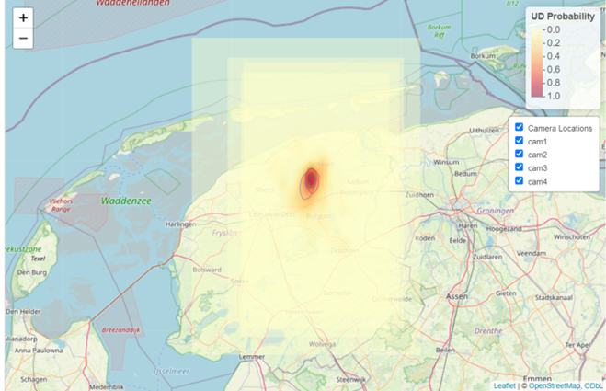
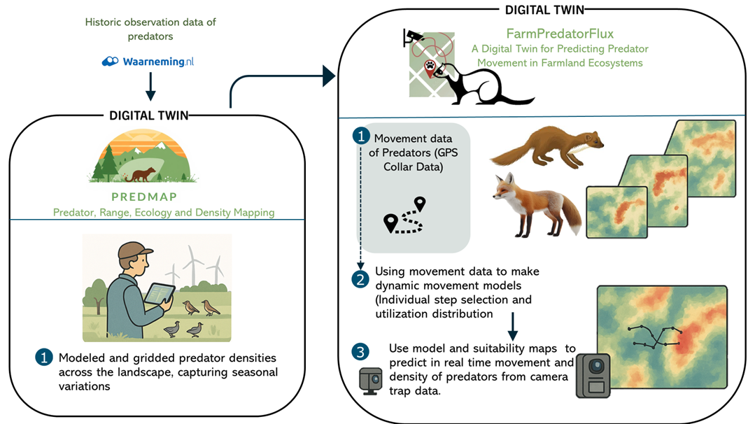
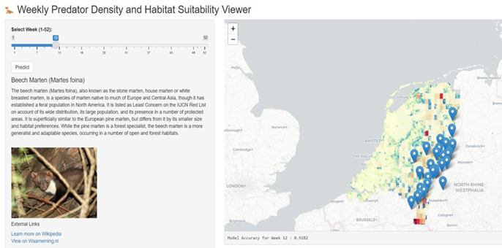

Slide 15
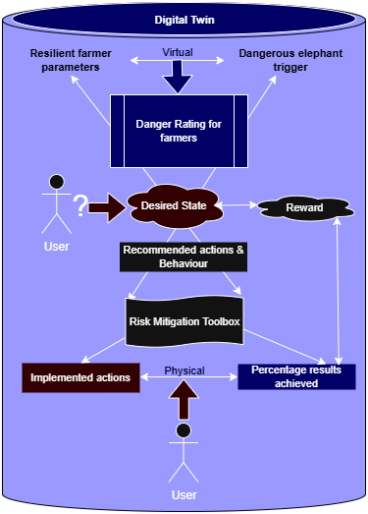
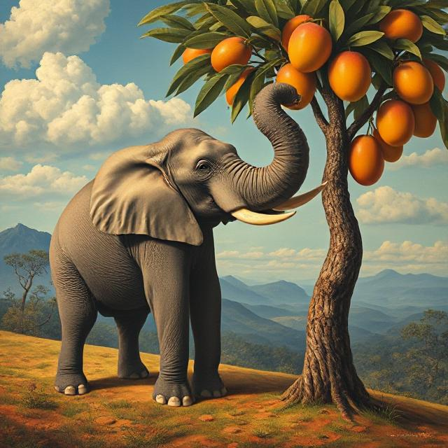
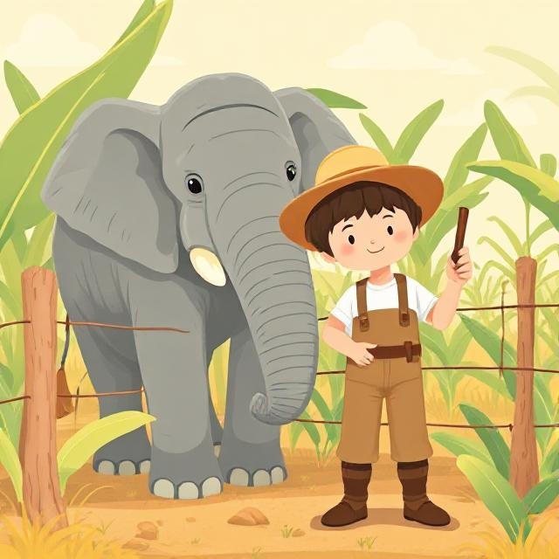
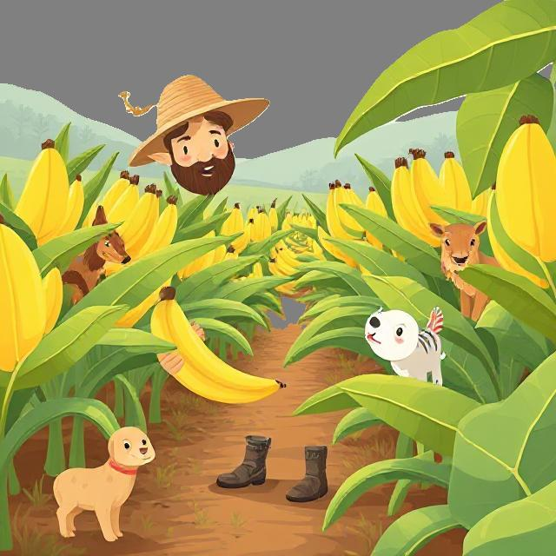
From Conflict to Co-existence
Model and
Domain Knowledge
Induced behavior change

Slide 16
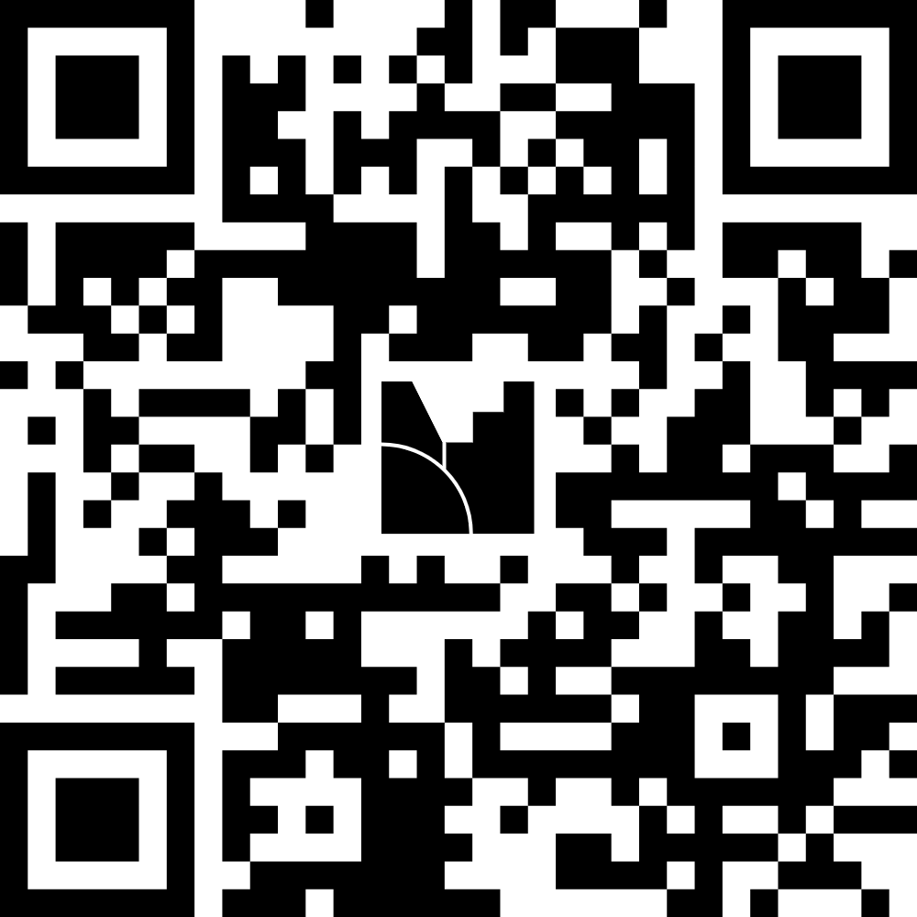
Join the Mentimeter!
Or join at menti.com | code 8747 4626

Slide 17
Group Work!
Every member of the group select a different colour posit
Write your answer to each question on your postit and stick it in the section
Briefly discuss each question in your team to give inspiration and find similarities
If you don't know what your answer would be, then leave it blank
Time: 25mins
Then we'll meet back to discuss what you found during the exercise

Slide 18
Thank You!
Anna Davison
anna.davison@wur.nl
https://www.linkedin.com/in/anna-davison-ecology/
Koen de Koning
koen.dekoning@wur.nl
Maitreyi Sur
maitreyi.sur@wur.nl
Franziska Steinbruch
franziska.steinbruch@wur.nl

Slide 19
Current Workshop Overview
00:00-00:15
Introduction to digital twins slides with examples from everyone in the team (x4)
00:15-00:20
Short interactive mentimeter to get some more information on the participants and split them into groups based on that
00:20-00:45
Group work session using the flip chart paper and sticky notes for each of the participants to work through identifying what they have and what they would need to create a DT
00:45-01:00
Share what has been found in the groups with the rest of the room and ask some concluding questions to wrap up the session (ensure that there are also some slides with out contact details)

